Slide 1

Dr. Devendra Jain
Assistant Professor
Department of Molecular Biology and Biotechnology
Maharana Pratap University of Agriculture and Technology
Udaipur (Rajasthan), India devendrajain@mpuat.ac.in; devroshan@gmail.com ; +91-9929840357
Nano-fertilizer and Green Synthesis of nano-particles and its effect on plant growth promotion

Slide 2
Fertilizers
Second biggest consumer of fertilisers. Import of urea during January, 2014 was 67.98 lakh metric tonnes, worth U.S. dollar 1,922.27 million.
Fertilizer use worldwide is increasing along with global population growth. Currently farmers are using nearly 85 percent of the world’s total mined phosphorus as fertilizer, although plants can uptake only an estimated 42 percent of the phosphorus that is applied to soil. If these practices continue, the world’s supply of phosphorus could run out within the next 80 years, worsening nutrient pollution problems in the process.
To remediate this, there is need to adopt more "smart" way i.e., nanotechnology can be one of the source. Since fertilizers are the main concern, developing nano based fertilizer would be a new technology in this field.
1
Enhancing food production
2
Improve the quality
3
Imbalanced fertilization
3(i)
Decreases soil organic matter
3(ii)
Depression in crop begun
3(ii)
Depression in soil

Slide 3
CHALLENGES & SOLUTIONS OF PRESENT AGRICULTURAL PRACTICES
Challenges | Solutions
In present agriculture fertilizer contributes to the tune of 50% of the agricultural production but increasing use higher doses of fertilizers does not guarantee to improved crop yield but it leads several problems like degradation of soil and pollution of surface and underground water resources. | Increase the fertilizer nutrient use efficiency and reduce doses.
High transportation cost of fertilizers due to require in large quantity | Decrease the application rate of fertilizers
More wastes of fertilizers material by using over doses in crop production | Value-addition to traditional fertilizers and reduce doses per unit area.
Multi nutrient deficiency in the soils | combine application of macro and micronutrient sources.

Slide 4
Nano- Fertilizers
Nano-fertilizers “Nano fertilizers are synthesized or modified form of traditional fertilizers, fertilizers bulk materials or extracted from different vegetative or reproductive parts of the plant by different chemical, physical, mechanical or biological methods with the help of nanotechnology used to improve soil fertility, productivity and quality of agricultural produces. Nanoparticles can made from fully bulk materials (Brunnet et al. 2006)
1
2
3
4
Increase efficiency of fertilizer
Increase uptake from soil in crop production
Extend the duration of nutrient supply of fertilizers
Reduce loss rate of fertilizer nutrients in to the soil by leaking

Slide 5
EFFECT OF NANOTECHNOLGY IN FERTILIZER
1
Encapsulation of fertilizer
Unique features of nano-fertilizers include ultrahigh absorption rate, increased production, photosynthesis and significant leaf SA expansion.
For example: Nano-urea increased grain yield by 10.2 % and agronomic efficiency of nitrogen fertilizer 44.5 % than normal urea.
The application of nano-urea can save up to 12.4-41.7 % of nitrogen application to the soil. (Huang et al., 2015).
2
Nano sized nutrients
3
Slow delivery
4
Targeted delivery

Slide 6
ADVANTAGE AND DISADVANTAGE
Nano- Fertilizers
Nano coating- reduce
cost
Poses problem toward
environment
Increase productivity
ADVANTAGE
DISADVANTAGE
Improvement in soil
aggregation
Nanoparticle are toxic
when entering human body
High yield than conventional

Slide 7
Comparison of Nano fertilizer and Conventional fertilizers applications
S.N0 | Properties | Nano-Fertilizers enabled technologies | Conventional technology
1 | Solubility and dispersion of mineral micronutrients | Nano-sized formulation of mineral micronutrients may improve solubility and dispersion of insoluble nutrient in soil absorption and fixation, and increase bioavailability. | Less bioavailability to plants due to large particle size and less solubility.
2 | Nutrient uptake efficiency | Increase fertilizer efficiency and uptake ratio of the soil nutrients in crop production and save fertilizer resources. | Bulk composite is not available for roots and decrease efficiency.
(Cui et al. 2010)

Slide 8
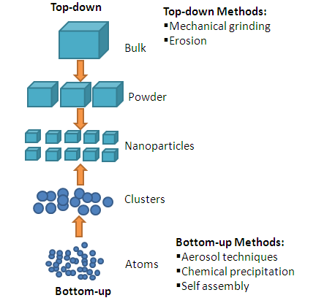
Biosynthesis of Nano Fertilizers

Slide 9
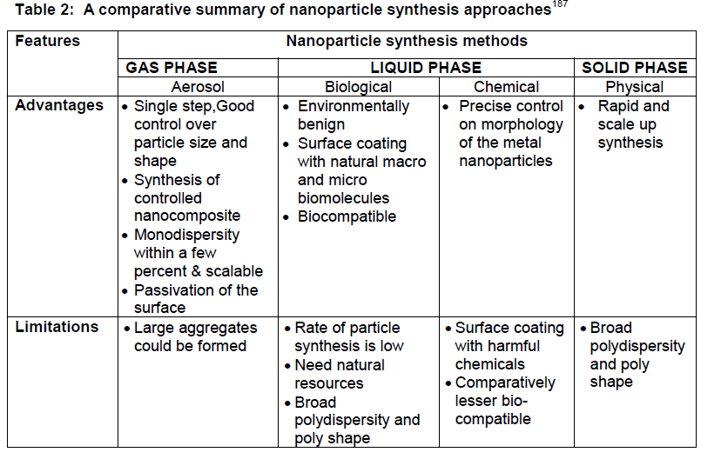
DOI: 10.1021/acs.jafc.7b02178

Slide 10
Nano fertilizer: Examples
Type of NP | NP property |  | Mode of treatment Plant | Plant | Observation
 | Size (nm) | Con. (ppm)
ESSENTIAL PLANT NUTRIENT
Carbon Carbon based NPs (CNT, Graphene) MWCNT; SWCNT; Fullerol | 1.5 -5 | 5-500 | Nutrient media and Foliar uptake; Seed treatment | Tomato, Tobacco Wheat; Gram Corn, Barley, rice, switchgrass etc. | Promote upregulation of stress related genes; Promote in vitro growth and biomass Enhanced root elongation Improving crop yield and seed quality Reduce heavy metal toxicity and stress
Nitrogen Urea HA | < 200 | 50 Kg/ha | Soil exposure | Rice | Slow release of nitrogen Improved rice yield
Phosphorous CaPo4, CMC – HA, Phosphorite Zn induced P | <50 | 10-100 | Soil and foliar applications | Cotton; Pearlmillets Beans, Wheat, Rye, Pea, Barley, Corn, Buckwheat, Radish, Cucumber | Protect against oxidative stress Mobilize native P and enhance uptake Enhances plant growth and yield
Magnesium MgO | <10 | 15 | Foliar | Clusterbean | Improving biomass, chlorophyll content &phenological growth
Manganese | 20 | 0.1 - 1 | Seed | Mung bean | Improve nitrogen uptake and metabolism
Copper Cu-Chitosan | >10 | 100 -1200 | Foliar & seed treatment | Corn, Tomato (Saharan et al 2015) | Enhanced , seedling growth, and biochemical activities
Zinc ZnO | 20-30 | 10 - 2000 | Foliar application Seed application | Peanut Beans Tomato Cotton Maize | Increase yield potential and plant growth Enhance phytohormone level and plant growth Help reduce drought stress and improve agronomic fortification

Slide 11
Non-essential nutrient
Type of NP | NP property |  | Mode of treatment Plant | Plant | Observation
 | Size (nm) | Con. (ppm)
Titanium TiO₂ | 5-100 | 200-600 | Seed, soil and foliar exposure | Spinach Lemna minor Tomato; Wheat Watermelon; Mung bean; Moth bean Pearl millet Clusterbean | Increased plant biomass and photosynthetic activity. Enhanced biochemical enzyme activity and light absorption by chloroplast; Increase photosynthesis, RuBISCO activity and carbon fixation Increasedgermination rate. Enhanced nitrogen metabolism
Cerium CeO | 8 -30 | 0.1-250 | Irrigation; Seed/root | Tomato Arabidopsis thaliana Cilantro; Wheat | Improved plant growth and yield Improved physiological and Molecular response Increase stress tolerance enzyme activity
Indium In₂O₃ | 20-70 | 250 | Seed/root | Arabidopsis thaliana | Improved physiological and molecular response
Silver Ag | 5-25 | 1 -10 | Hydroponics, Soil | Poplars Arabidopsis thaliana;Clover | Influence phyto-stimulatory effect Increase nutrient absorption by enhancing microbial activity in rhizosphere
Upconverson nanophosphore | n/a | 10 | Sprouts | Mung bean | Promote plant growth
Silica Si SiO SiO₂ | 8-15 | 5-800 | Soil irrigation, Seed &Root exposure | Tomato Wheat, Lupin Larix olgensis | Help overcome from salinity stress and enhance plant growth Enhance germination and growth Enhancement in total protein and chlorophyll content. Promoted seedling growth and quality
Cobalt ferrite | n/a | 1 – 1000 | Root exposure | Tomato | Promote root growth

Slide 12
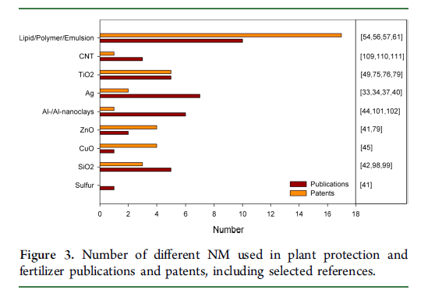


Slide 13
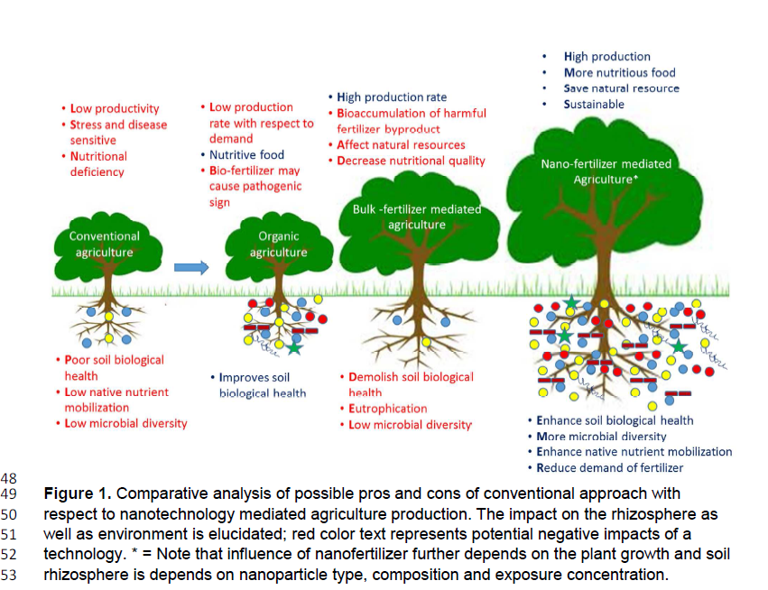
DOI: 10.1021/acs.jafc.7b02178

Slide 14
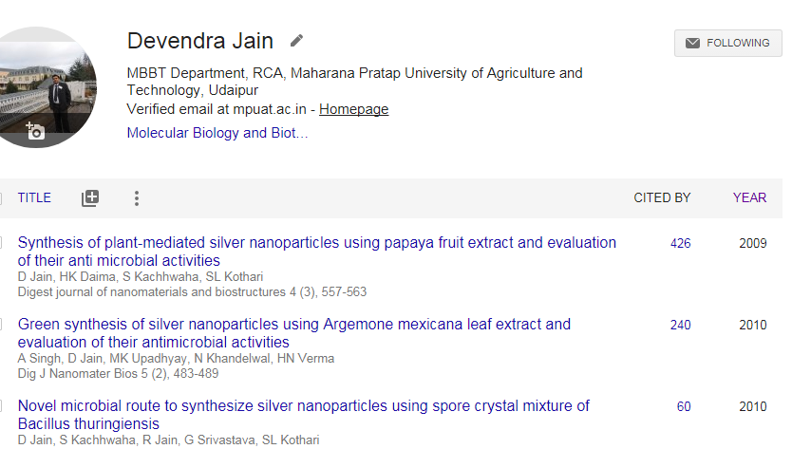

Slide 15
Iron Oxide Nanoparticles
The Iron oxides are of special importance owing to their use in pigments, magnetic recording devices, MRI contrast enhancement agents, biological sensors, anticorrosive agents and catalysts also can be used as photocatalysts.
The methods used so far for the synthesis of iron oxide Nanoparticles include arc discharge, micro emulsions, hydrothermal reaction method, sol-gel method, chemical co-precipitation etc.
A simple, cheap, and one-step process for green synthesis of iron oxide nanoparticles by simple aqueous precipitation was developed.

Slide 16
Iron Oxide Nanoparticles
The Iron oxides are of special importance owing to their use in pigments, magnetic recording devices, MRI contrast enhancement agents, biological sensors, anticorrosive agents and catalysts also can be used as photocatalysts.
The methods used so far for the synthesis of iron oxide Nanoparticles include arc discharge, micro emulsions, hydrothermal reaction method, sol-gel method, chemical co-precipitation etc.
A simple, cheap, and one-step process for green synthesis of iron oxide nanoparticles by simple aqueous precipitation was developed.

Slide 17
Iron Oxide Nanoparticles
Metallic nanoparticles are traditionally synthesized by wet chemical techniques, where the chemicals used are quite often toxic and flammable .
Green synthesis method is cost effective, environment friendly, single step method, easily scaled up and does not requires high pressure, energy, temperature and toxic chemicals. The synthesis of Fe₃O₄ and Fe₂O₃ was developed using plant extract.

Slide 18
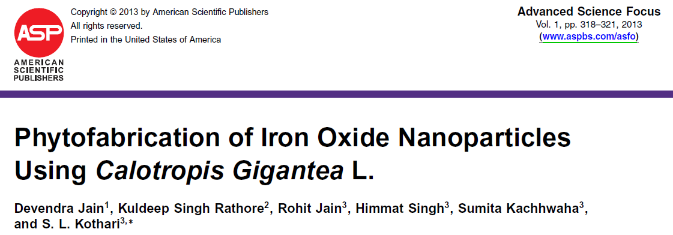
Plant material and preparation of extract: Green Calotropis gigantea leaves were used to make the aqueous extract.
Synthesis of Iron oxide nanoparticles: In the formation of Iron oxide Nanoparticles , first of all 10mM solution of Ferric Chloride (FeCl₃) was prepared in 100 ml MQ water and then the solution was boiled till it was dark red in color. 20 ml of above plant extract was then added in 80 ml of 10 mM FeCl₃ solution and stirred vigorously for 24 hr.

Slide 19
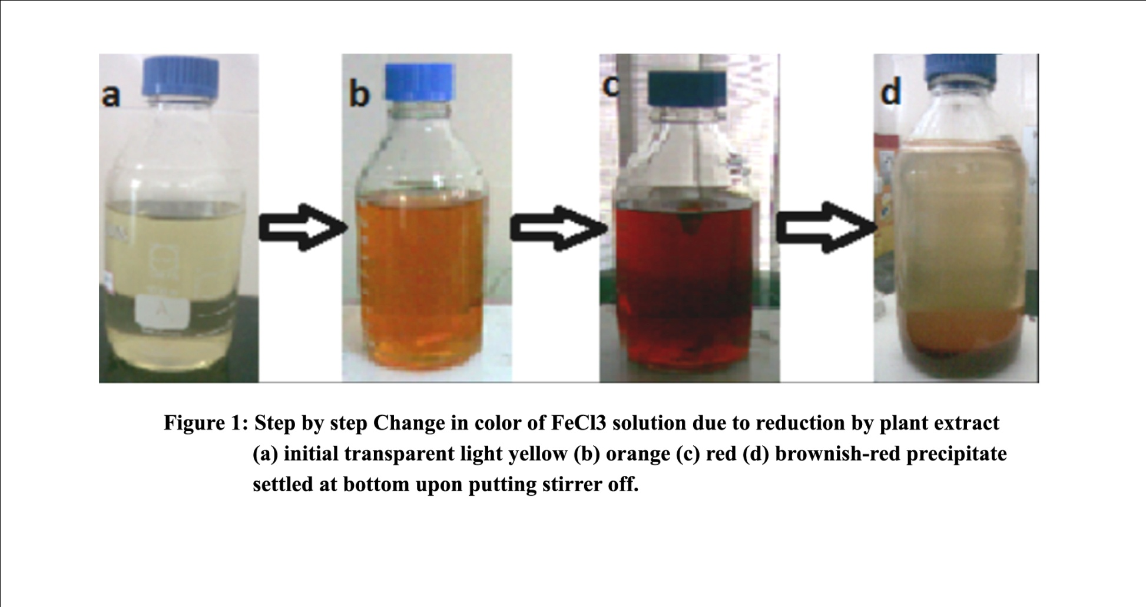
Green Synthesis

Slide 20
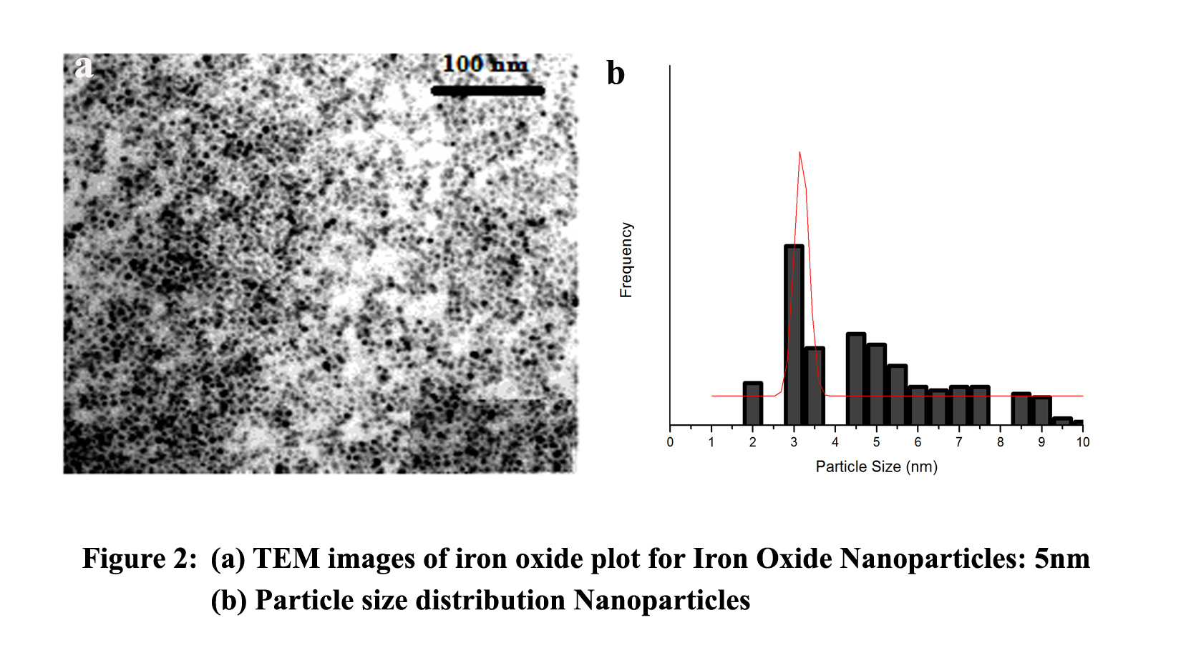
Characterization of NPs

Slide 21
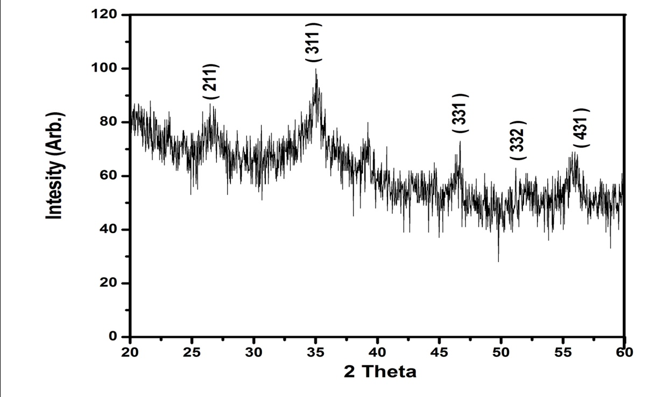
Characterization of FeO NPs
The typical XRD pattern revealed that the sample contains a face- centred cubic structure of FeO NPs . The average estimated particle size of this sample was 05 nm.

Slide 22
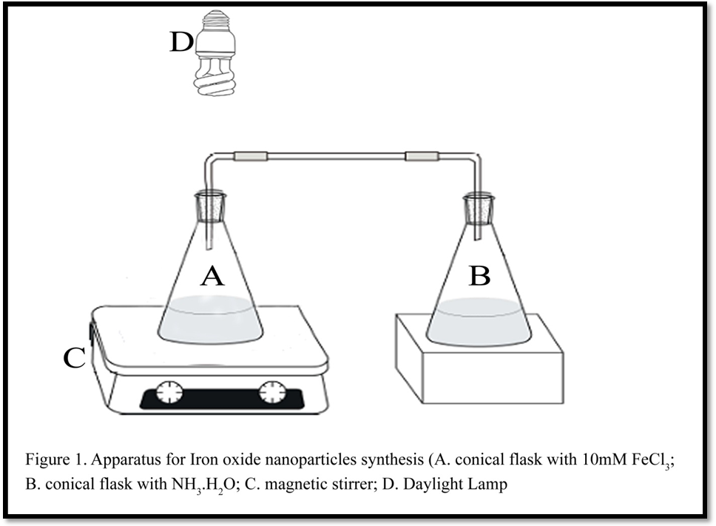
Green Synthesis of FeO NPs using Ammonia

Slide 23
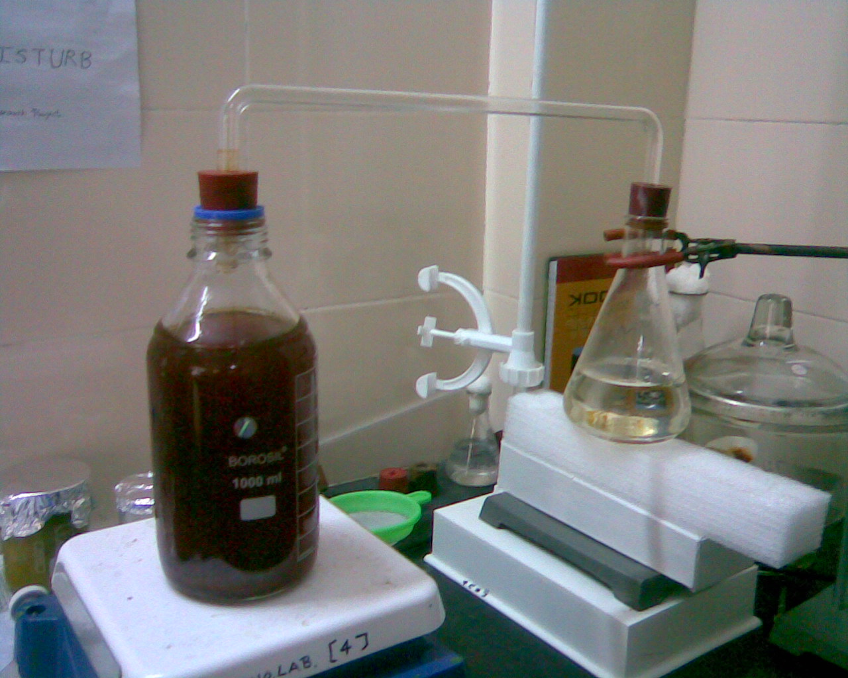
Green Synthesis of FeO NPs using Ammonia

Slide 24
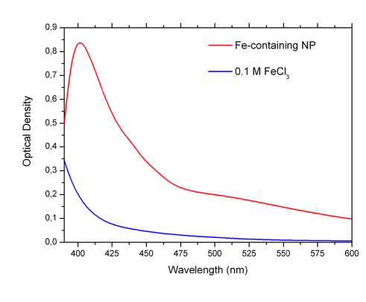
Characterization of FeO NPs

Slide 25
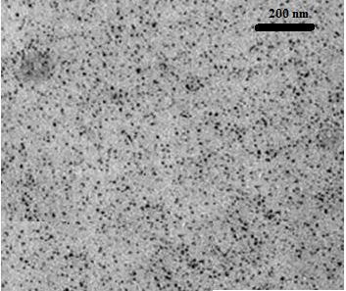
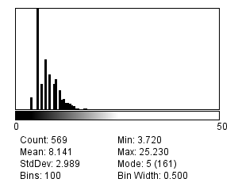
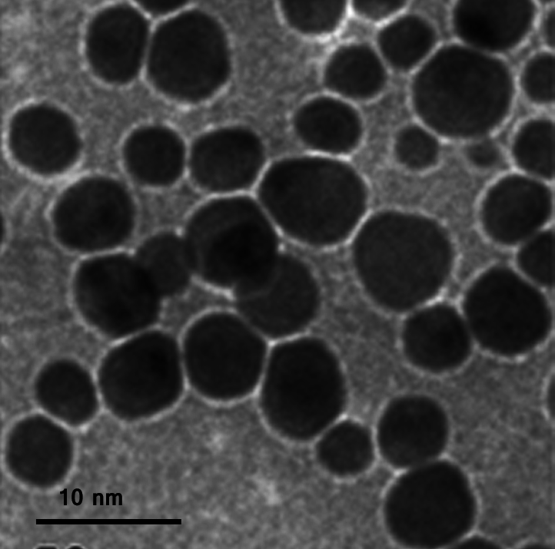
Characterization of FeO NPs
A
B
Figure 3: (A) TEM image (B) Particle size distribution of Iron oxide nanoparticles

Slide 26
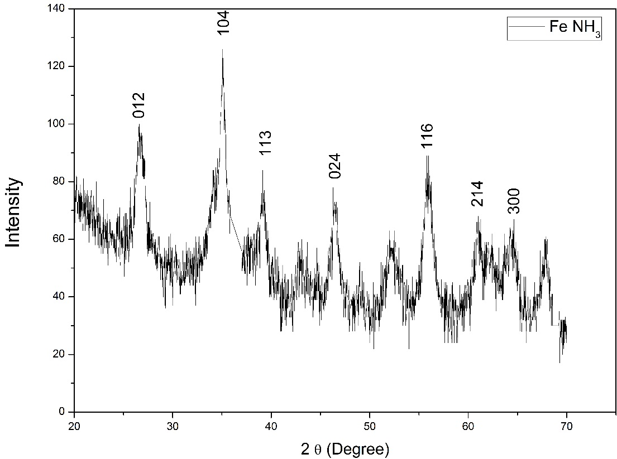
Characterization of FeO NPs
Figure 4: XRD pattern of iron oxide nanoparticles

Slide 27
Characterization of FeO NPs
Sample | T (°C) | ZP (mV) | Mob (µmcm/Vs) | Cond (mS/cm)
Fe-np | 24.9 | 7.49 | 0.5873 | 0.154
Zeta potential distribution of Iron oxide nanoparticles

Slide 28
Dye degradation (AO) potential of FeO NPs
Absorbance at 491nm
Time in min

Slide 29
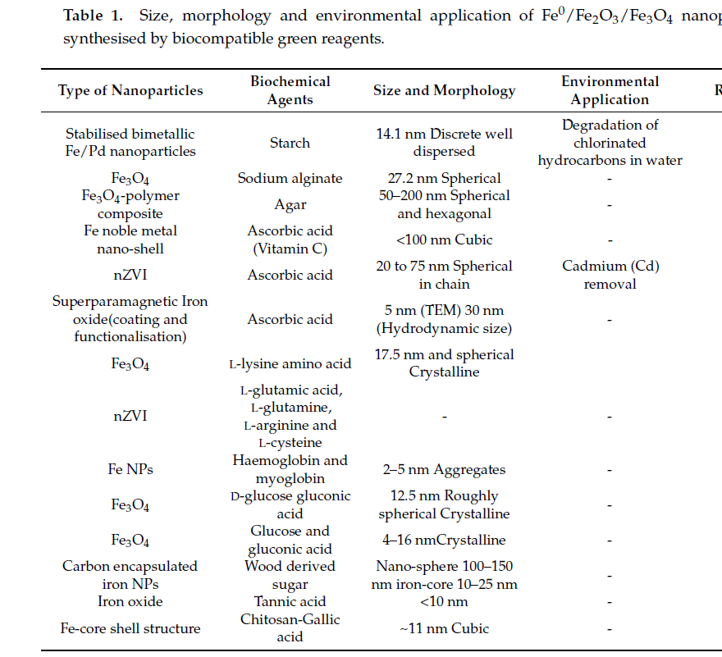

Slide 30
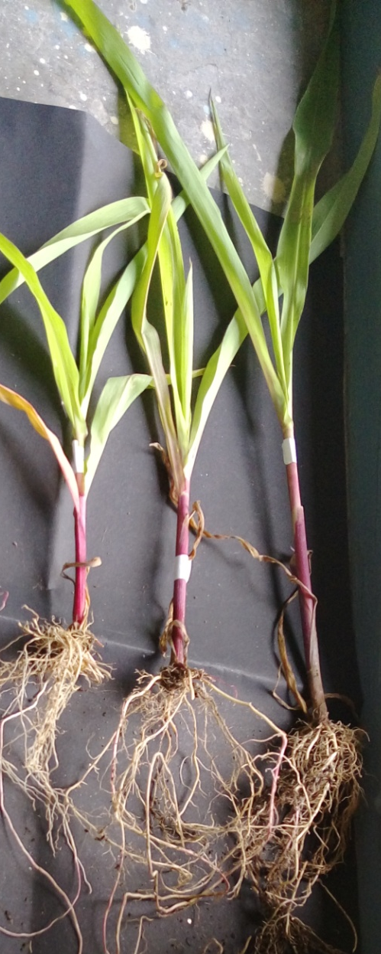
Plant Growth Promotion activities of FeO NPs
Treatment | Total Chlorophyll (mg/g fw)
Without Iron supplement | 0.54
With Fe-EDTA (50 ppm) | 1.35
With FeO NPs (50 ppm) | 1.56

Slide 31
Green Synthesis of Ag NPs
We used environment friendly technique for green synthesis of silver nanoparticles from AgNO₃ solution through Tagetes patula L. as reducing agent.
Nanoparticles were characterized using UV–Vis absorption spectroscopy, FTIR, XRD, SEM and TEM
5 ml of plant extract was added into 95 ml of aqueous solution of 1mM AgNO₃ for reduction into Ag.

Slide 32
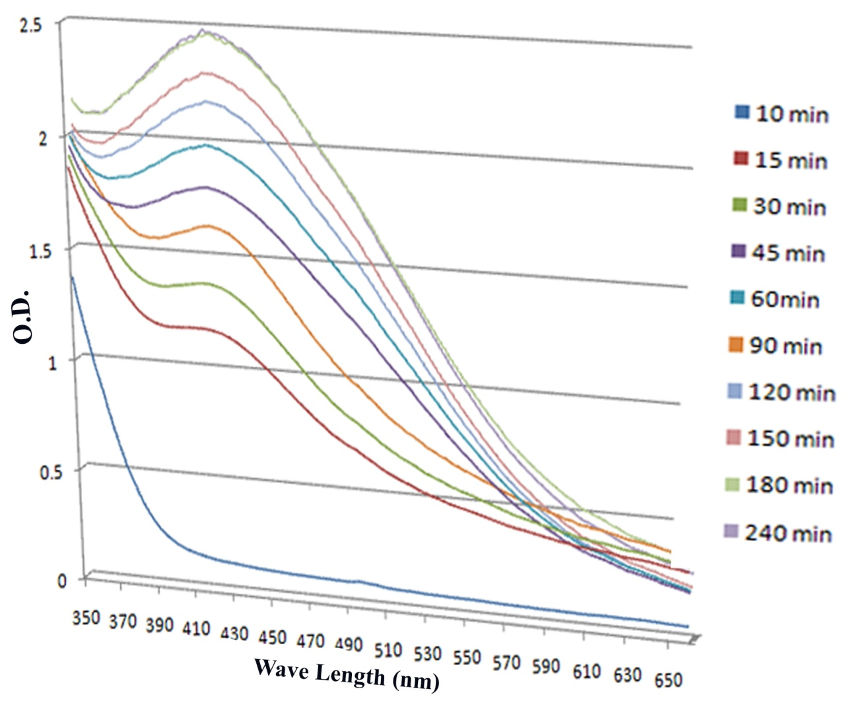
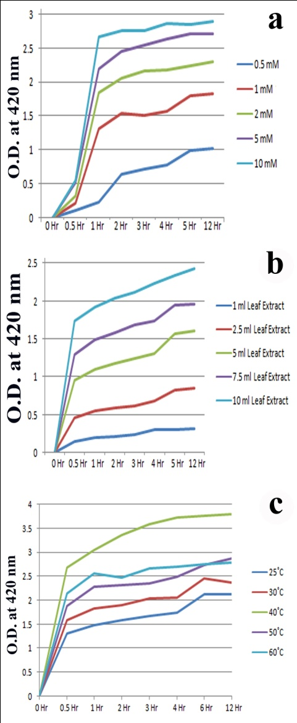
Characterization of AgNPs

Slide 33
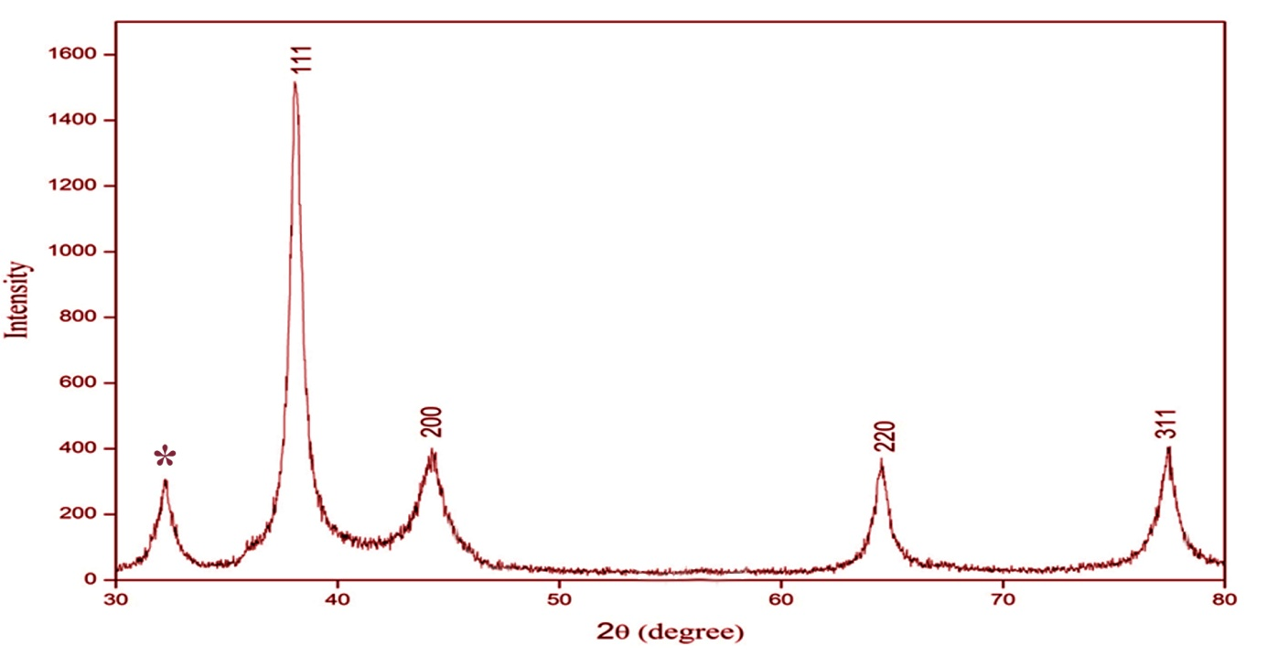
Characterization of AgNPs
XRD: After freeze drying of the purified silver particles, the structure and composition were analyzed by XRD.
The typical XRD pattern revealed that the sample contains a mixed phase (cubic and hexagonal) structures of silver nanoparticles. The average estimated particle size of this sample was 15 nm.

Slide 34
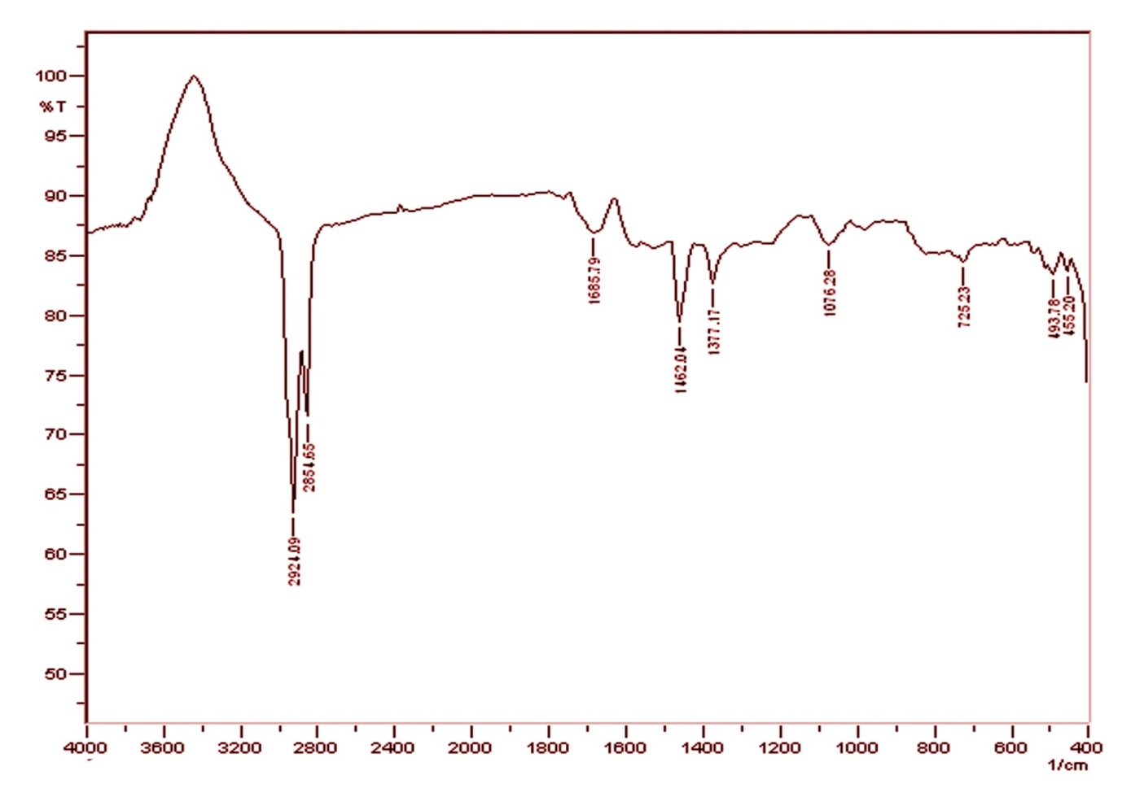
Characterization of AgNPs
This strong absorption is due to the presence of surface adsorbed alcohols (carbohydrates etc.) and phenols (polyphenols).
FTIR study indicates that the carboxyl (−C=O), hydroxyl (−OH), and amine (N–H) groups in leaf extract are mainly involved in the reduction of Ag+ to Ag nanoparticles. This was confirmed by the FTIR spectra of aqueous leaf extract

Slide 35
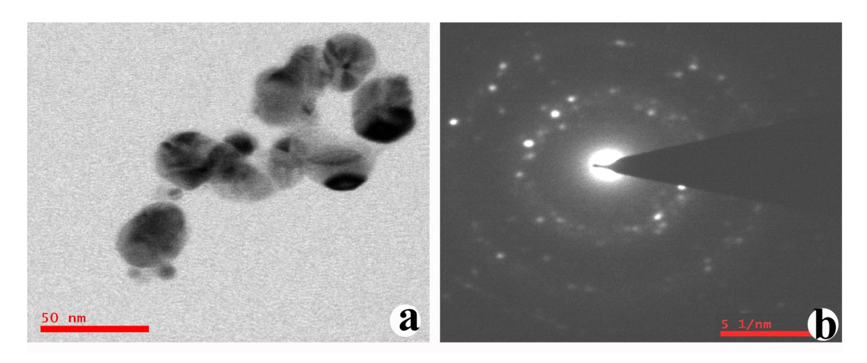
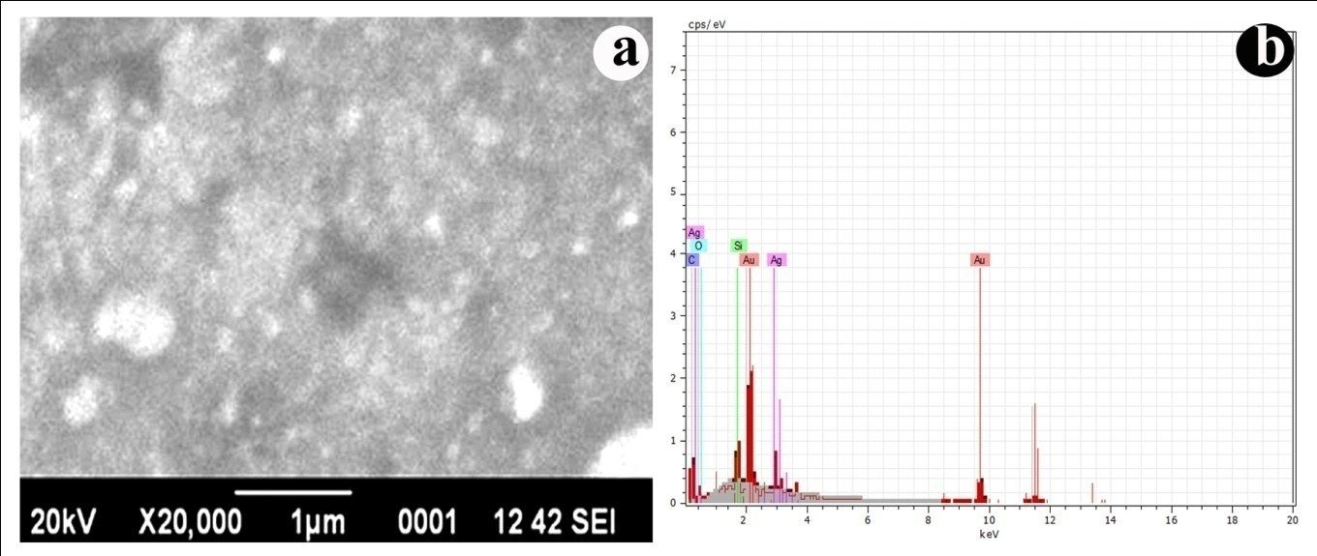
Characterization of AgNPs

Slide 36
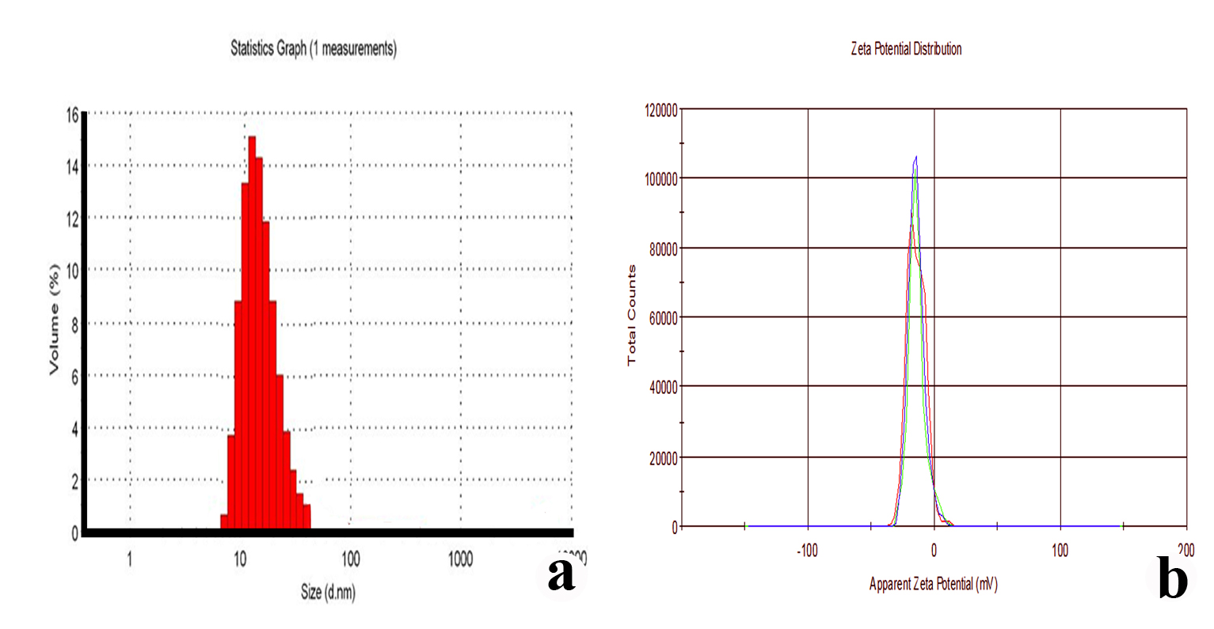
Characterization of AgNPs
Dynamic Light Scattering (DLS) and Zeta potential analysis

Slide 37
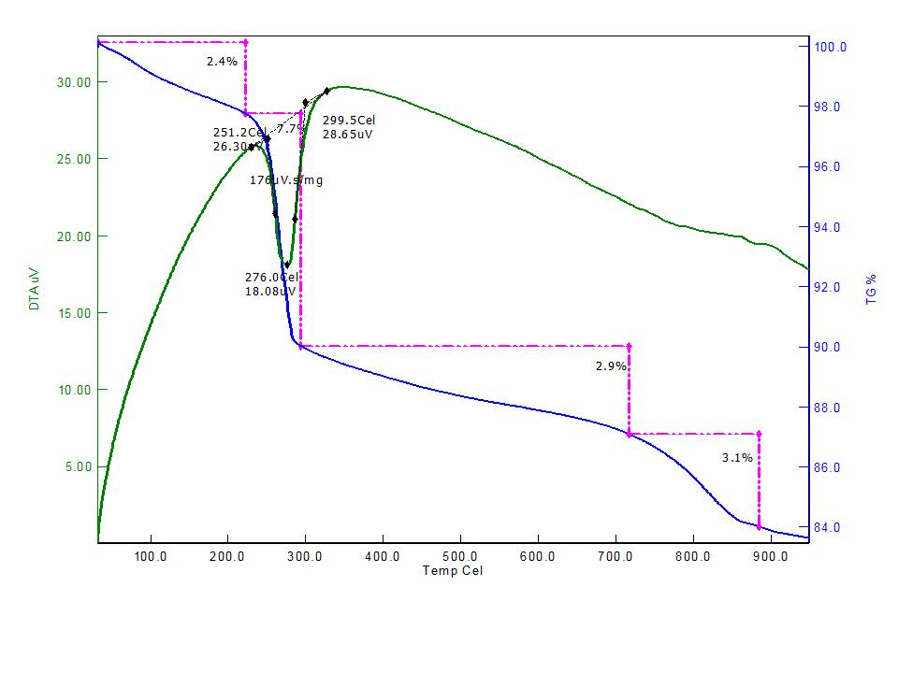
Characterization of AgNPs
TG/DTA studies

Slide 38
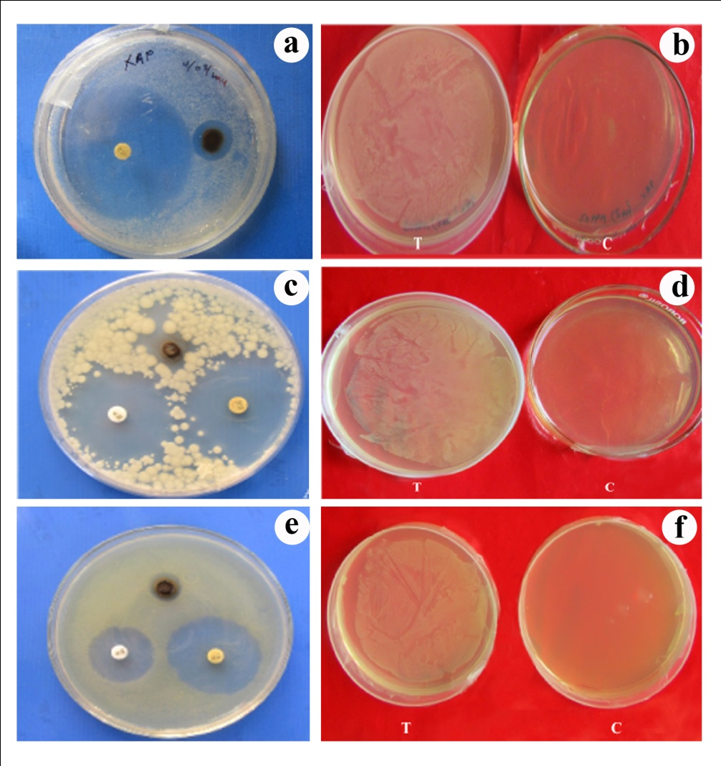
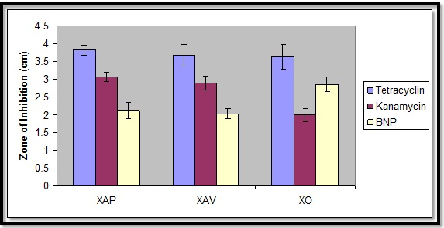
Antibacterial Activity of AgNPs

Slide 39
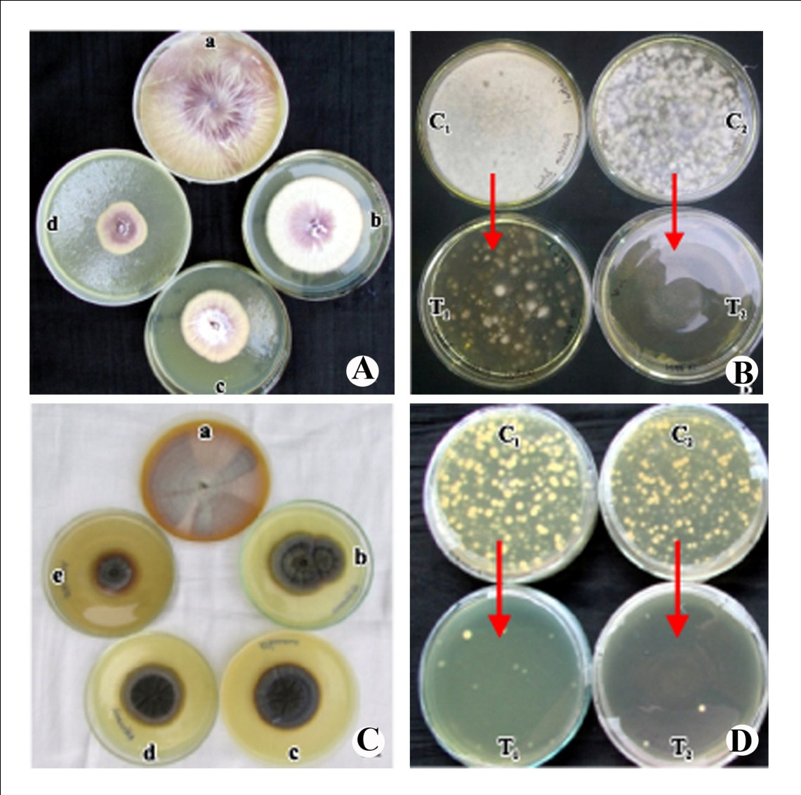
Antifungal Activity of AgNPs
Fusarium solani mycelial growth inhibition by poison food technique (a. Control, b. 100 ppm, c. 300 ppm & d. 500 ppm)
(B) Fusarium solani spore germination inhibition by pour plate technique
(C) Alternaria sp. mycelial growth by poison food technique ( a. Control, b. 100 ppm, c. 200 ppm, d. 300 ppm & e.500 ppm)
(D) Alternaria sp. spore germination inhibition by pour plate technique. C = Crude spore suspension; C2 = 10⁻¹ times diluted spore suspension; T₁ & T₂ = BNP Treatment (500 ppm)

Slide 40
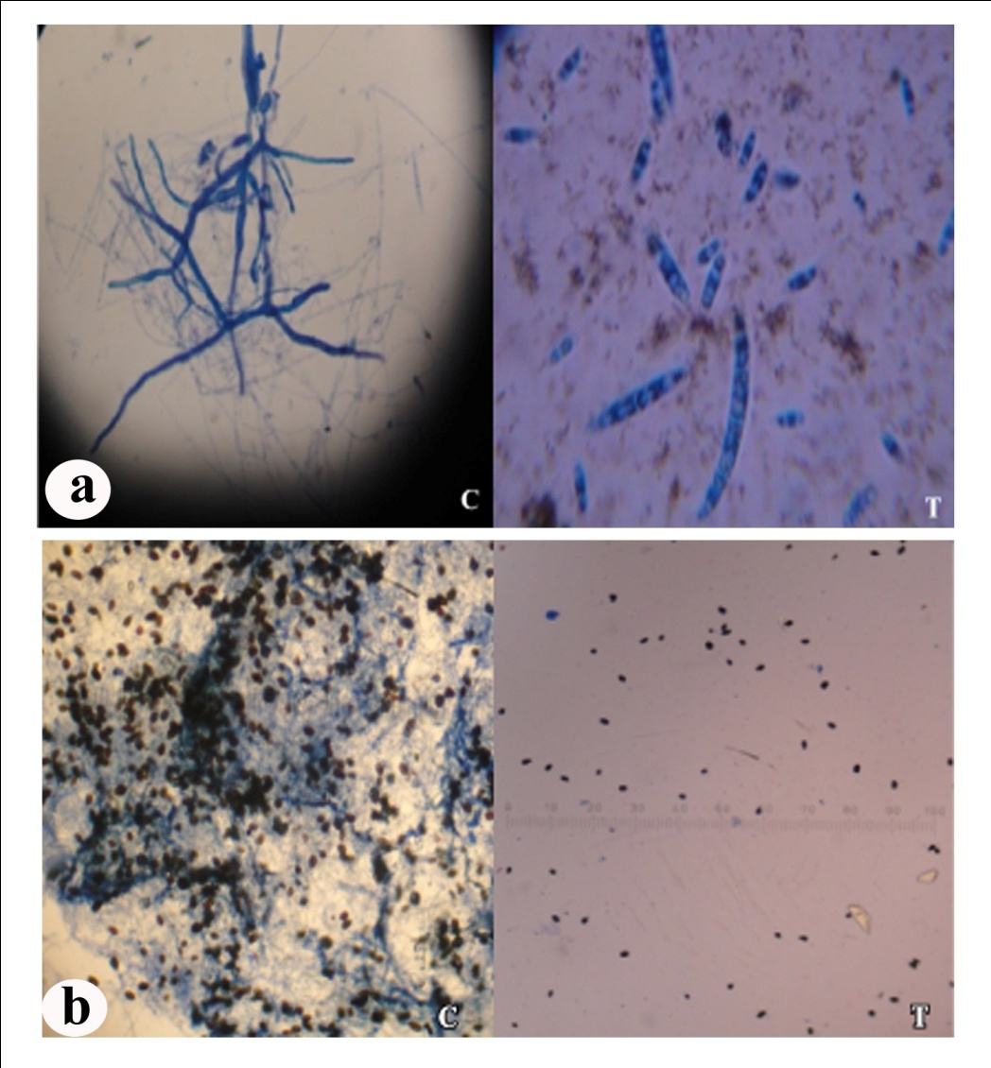
Antifungal Activity of AgNPs
Treatment | % inhibition Mycelia growthª | % inhibition Spore Germinationª
F. solani
Control^{d} | 0.0D | 13.80±1.14 D
100 ppm | 30.36±0.39C | 65.04±1.70 C
300 ppm | 49.97±0.81B | 75.57±0.55 B
500 ppm | 61.5±0.34A | 90.15±1.8 A
Alternaria sp.
Control^{d} | 0.0D | 13.80±0.95 D
100 ppm | 30.21±0.83C | 65.04±0.57 C
300 ppm | 48.51±1.34B | 75.57±1.25 B
500 ppm | 58.81±0.92A | 90.15±2.37 A
F. oxysporum
Control^{d} | 0.0 E | NA
10 ppm | 20.07 ± 0.64 D | NA
25 ppm | 25.71 ± 0.82C | NA
50 ppm | 30.05 ± 0.99B | NA
100 ppm | 33.1 ± 1.08B | NA
500 ppm | 69.78 ± 0.34A | NA
1000 ppm | 73.36 ± 0.80A | NA
Each value is mean of 3 replicates from 2 experiments. Mean ± SE followed by same letter in column of each treatment is not significant difference at p = 0.05 by Tukey–Kramer HSD test, % inhibition rate was calculated compared to the germination of the control (0%). ^{d}Control without any formulation.
Microscopic studies of spore germination inhibition of BNP against (a) Fusariumsolani (b) Alternaria sp. C = Control, T =Treatment (500 ppm).

Slide 41
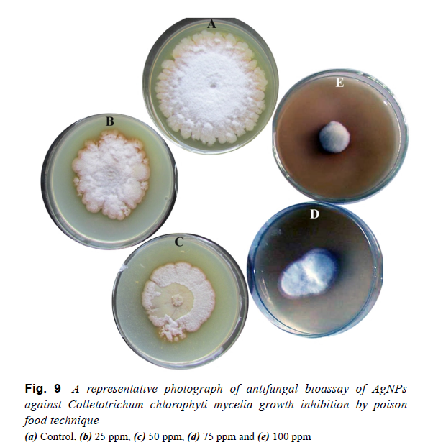
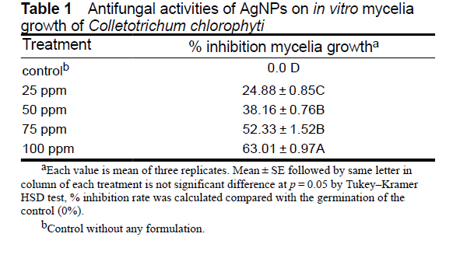
Antifungal Activity of AgNPs

Slide 42
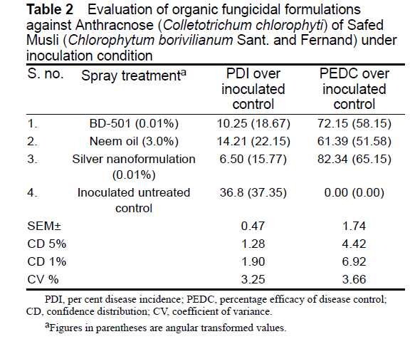
Antifungal Activity of AgNPs

Slide 43
Antiviral Activates of AgNPs
Antiviral activities of silver nanoparticles (50 mg/l) on SHRV using Gaur as a host system

Slide 44
Antiviral Activates of AgNPs
TEM micrograph of SHRV along with
Silver nanoparticles (50mg/l)
TEM micrograph of SHRV Virus

Slide 45
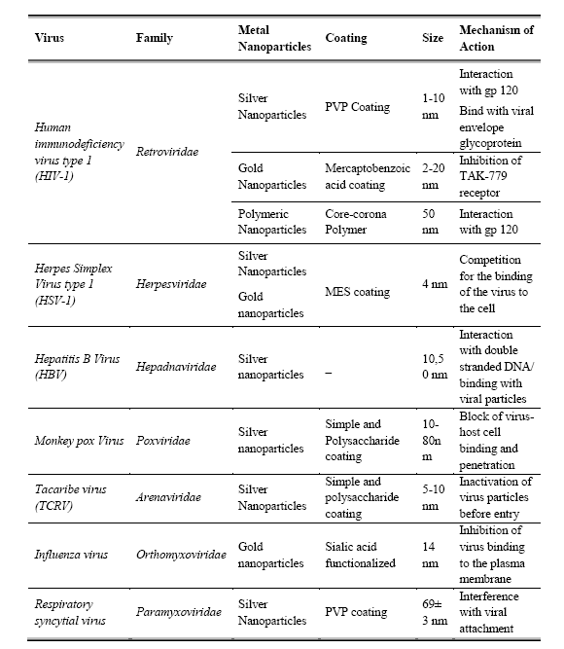

Slide 46
Conclusion
Conventional farming practices are becoming increasingly inadequate, coupled with increasing demands of the terrestrial ecosystem.
Adoption of new technologies is crucial if production is to be increased to match the demands for food, fodder and fiber.
Nanotechnology guarantees a breakthrough in;
  Improve the nutrient use efficiency through nanoformulation of fertilizers,
  Breaking yield and nutritional quality barriers through bionanotechnology,
  Surveillance and control of pests and diseases,
  However, requires a detailed understanding of science, as well as fabrication and material technology, in combination with knowledge of the agricultural production system. For it to flourish, continuous funding and understanding on the part of policy makers and science administrators, along with reasonable expectations, would be crucial for this promising field.

Slide 47
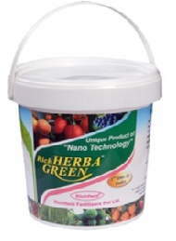
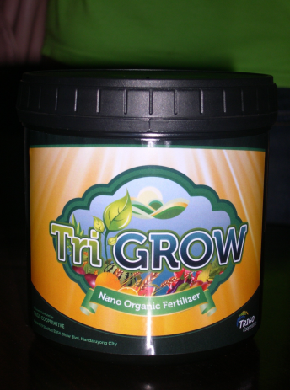
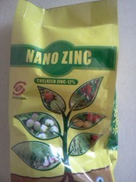
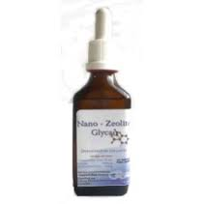
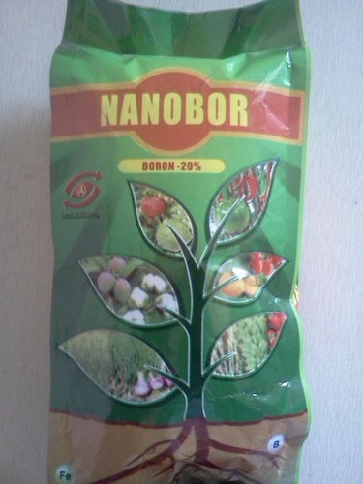
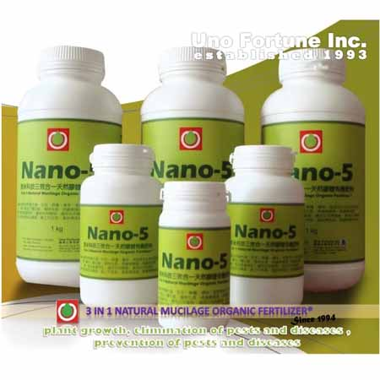
Future Prospects
Rich Herba Green
Trigrow nano organic fertilizer

Slide 48
Thank You

